Slide 1
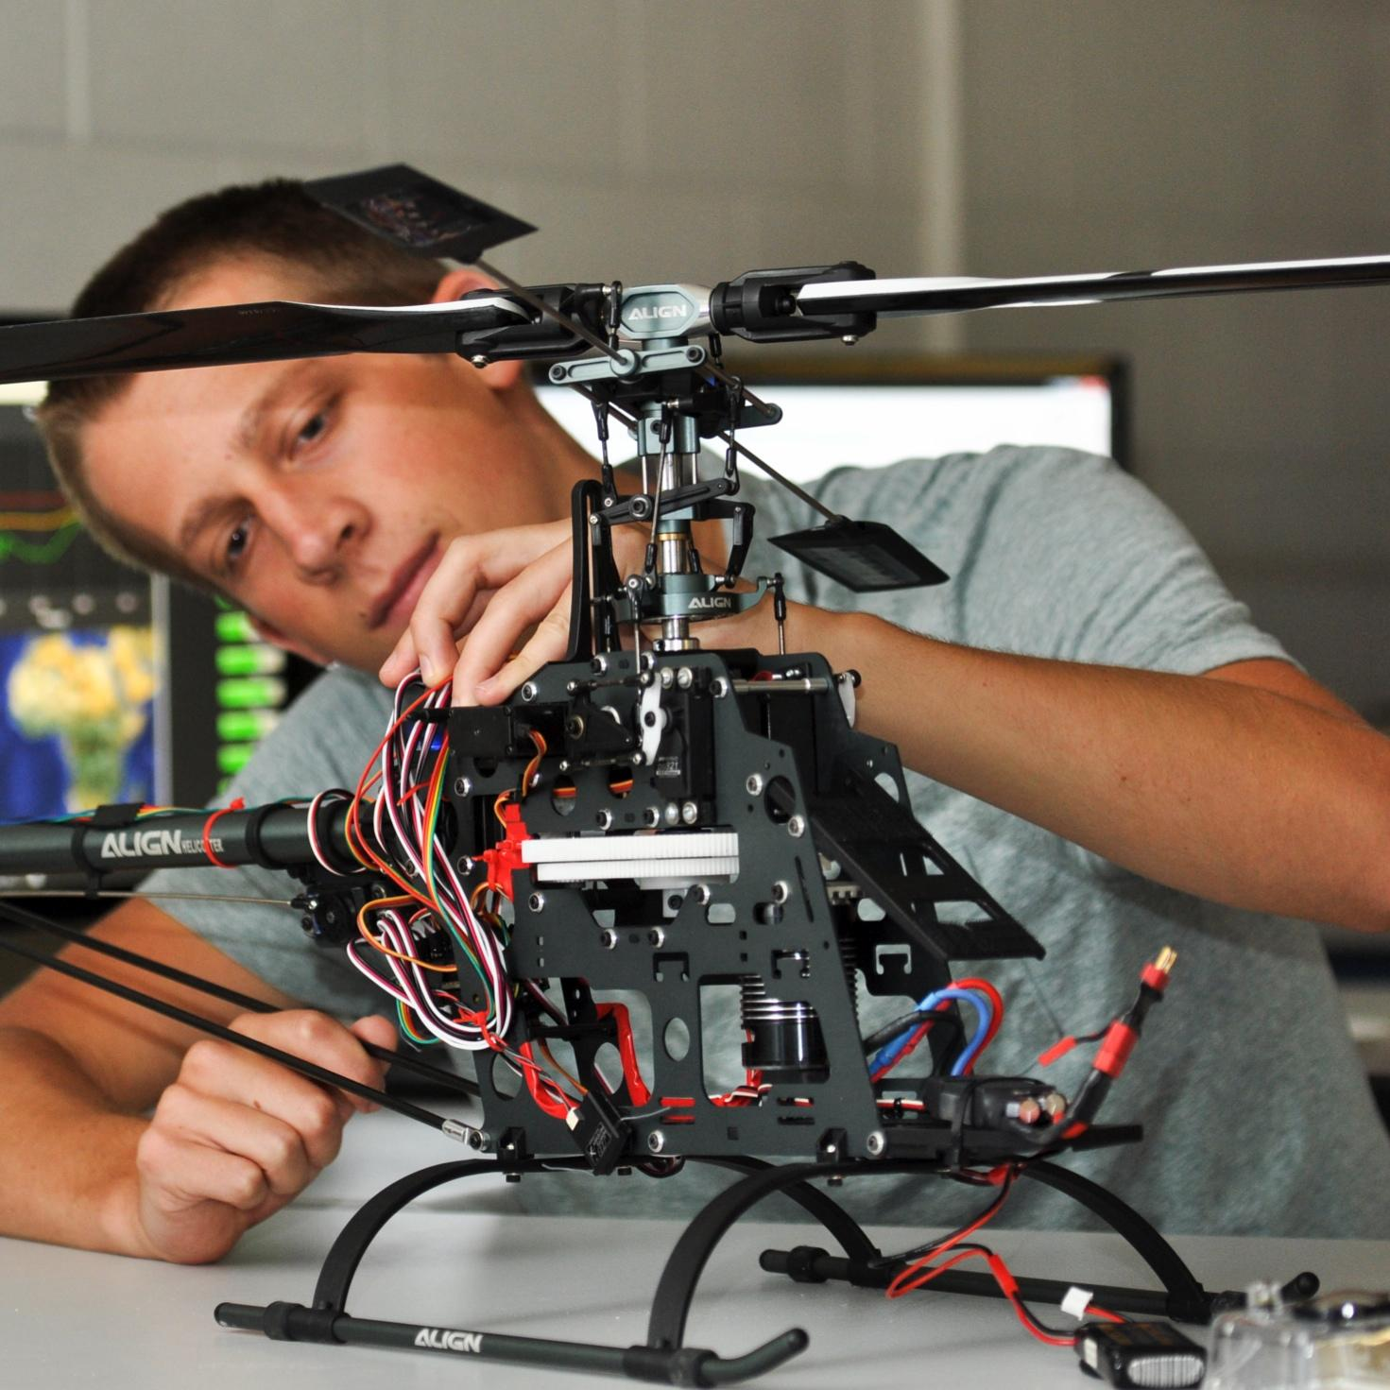

TMEIC DI-Water Cooling Skid
Bi-Weekly Update 4
Ethan Henderson
Robert Parker
Noah Ovikian
Sponsor: TMEIC
TA: Jerry Xu
Notes:
Michelle

Slide 2
Project Summary
Problem Statement
TMEIC’s high-power VFDs rely on deionized-water cooling to protect inverter IGBTs from damaging heat. Using a full-scale cooling system for customer training is costly, cumbersome, and impractical, yet trainees still need realistic operating and troubleshooting scenarios.
Our Solution
We are designing and building a compact, temperature-controlled DI water cooling skid for TMEIC’s training facility. It will reproduce the behavior of the full-scale system, enabling accurate hands-on testing, diagnostics, and troubleshooting at a fraction of the scale, cost, and complexity.

Slide 3
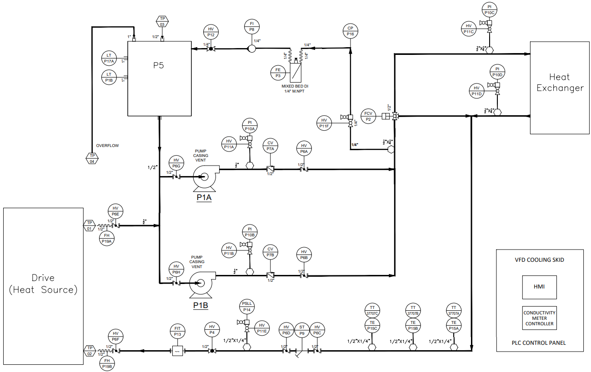
Project Summary

Slide 4
Project Summary

Slide 5
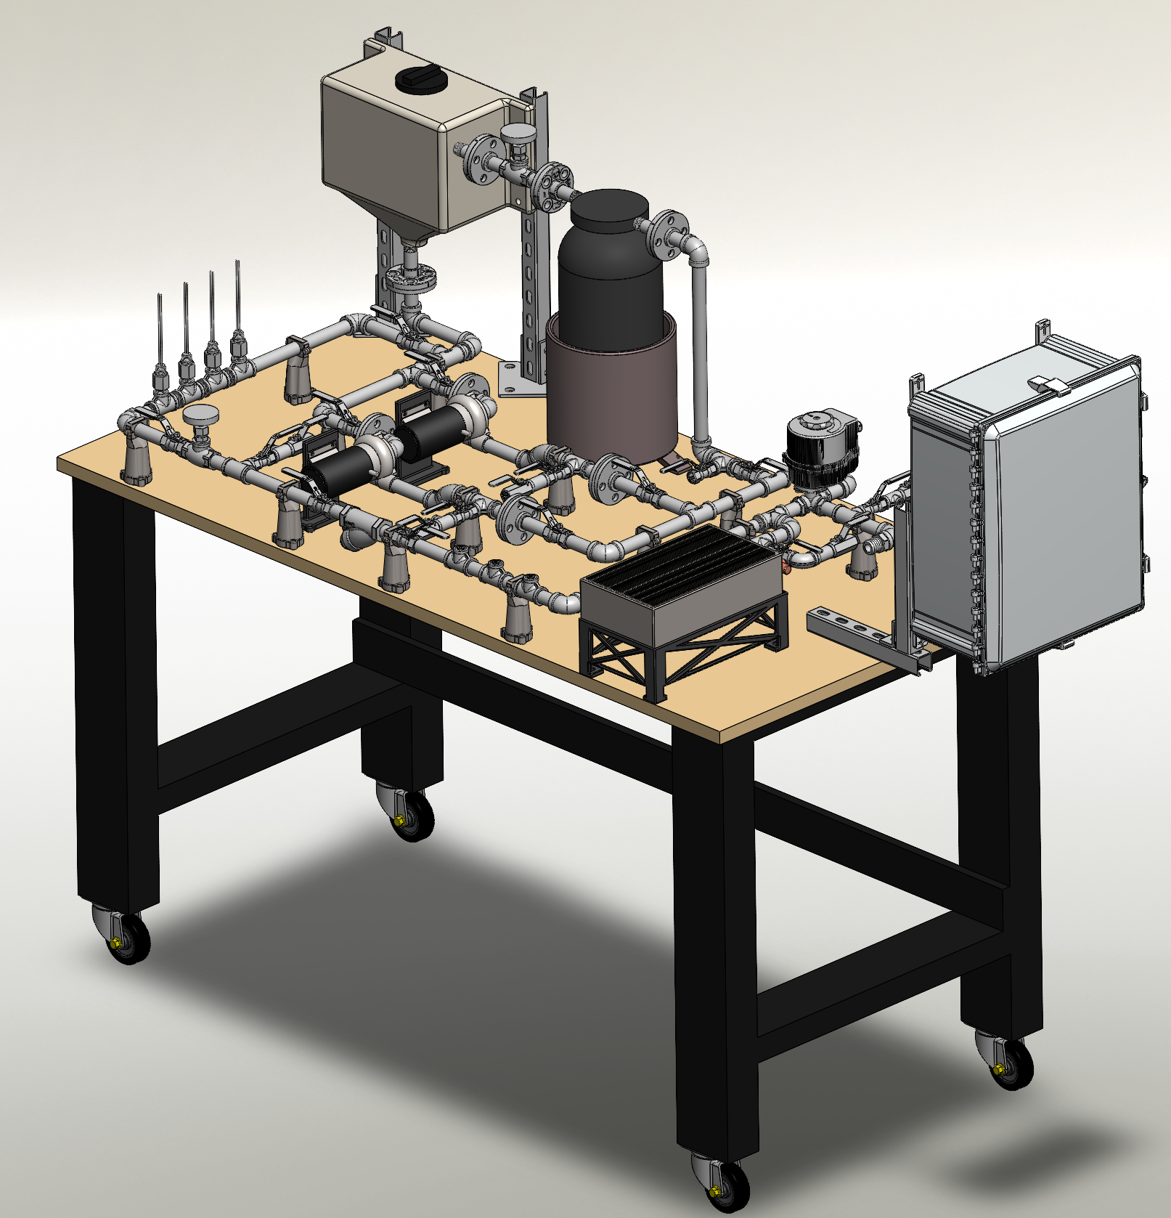
Project Summary

Slide 6
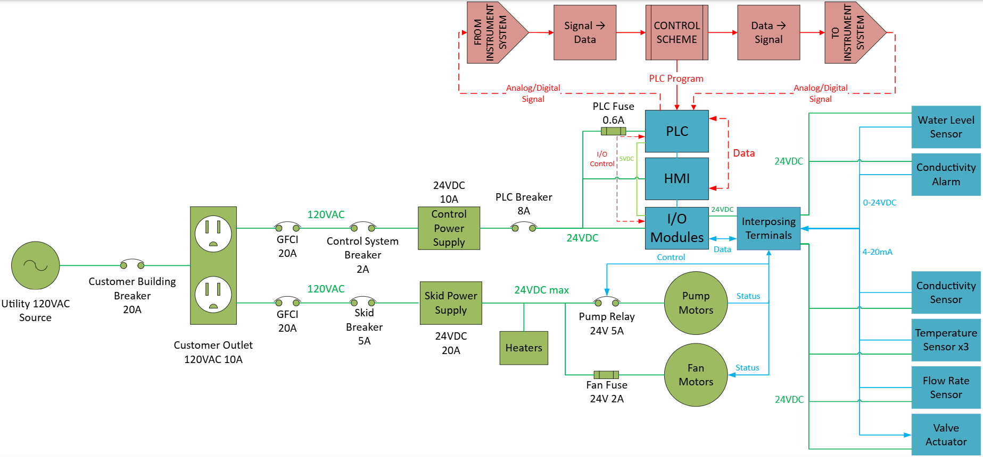
System Overview
Ethan Henderson
Robert Parker
Noah Ovikian

Slide 7
Phase II & III Timeline
OCT 5
Phase I Test Complete
OCT 12
Phase II Skid Construction
Resin filtration loop
OCT 19
Full Skid Assembly Start
Add heating and get proper piping installed
OCT 7
OCT 15
OCT 5
OCT 7
Phase III Construction & Testing Start
Tested HX with and without fan assist
OCT 12
OCT 15
Phase II Test Complete
Resin loop head loss and conductivity validation
OCT 19
Complete
In Progress
Behind Schedule
Not Started
*Contains AI generated content*

Slide 8
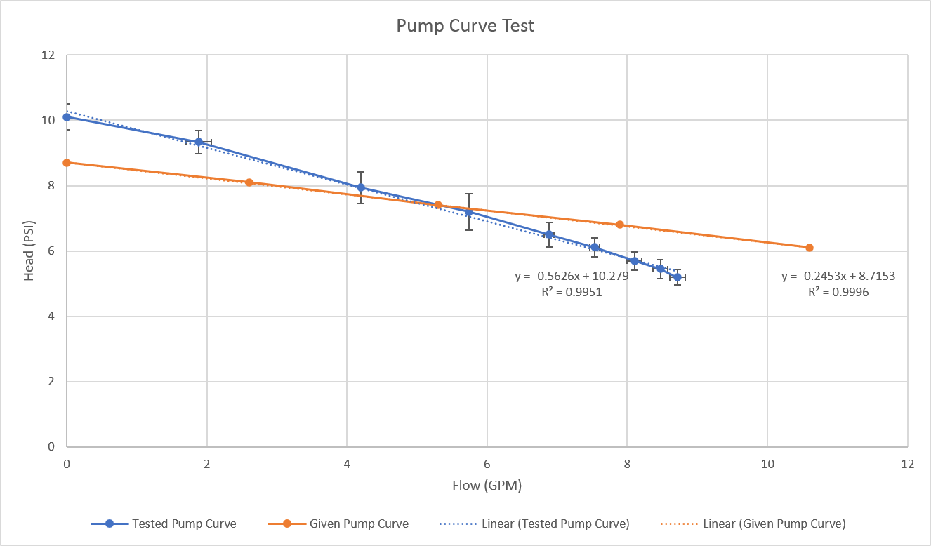
Phase I, II, and III Test Results
Manufacturer Pump Curves reflect controlled tested conditions. Our pump curve shows the effect the skid construction has on the operational capability of the pump which is the intent of the Phase I Test.
Phase I Test Results

Slide 9
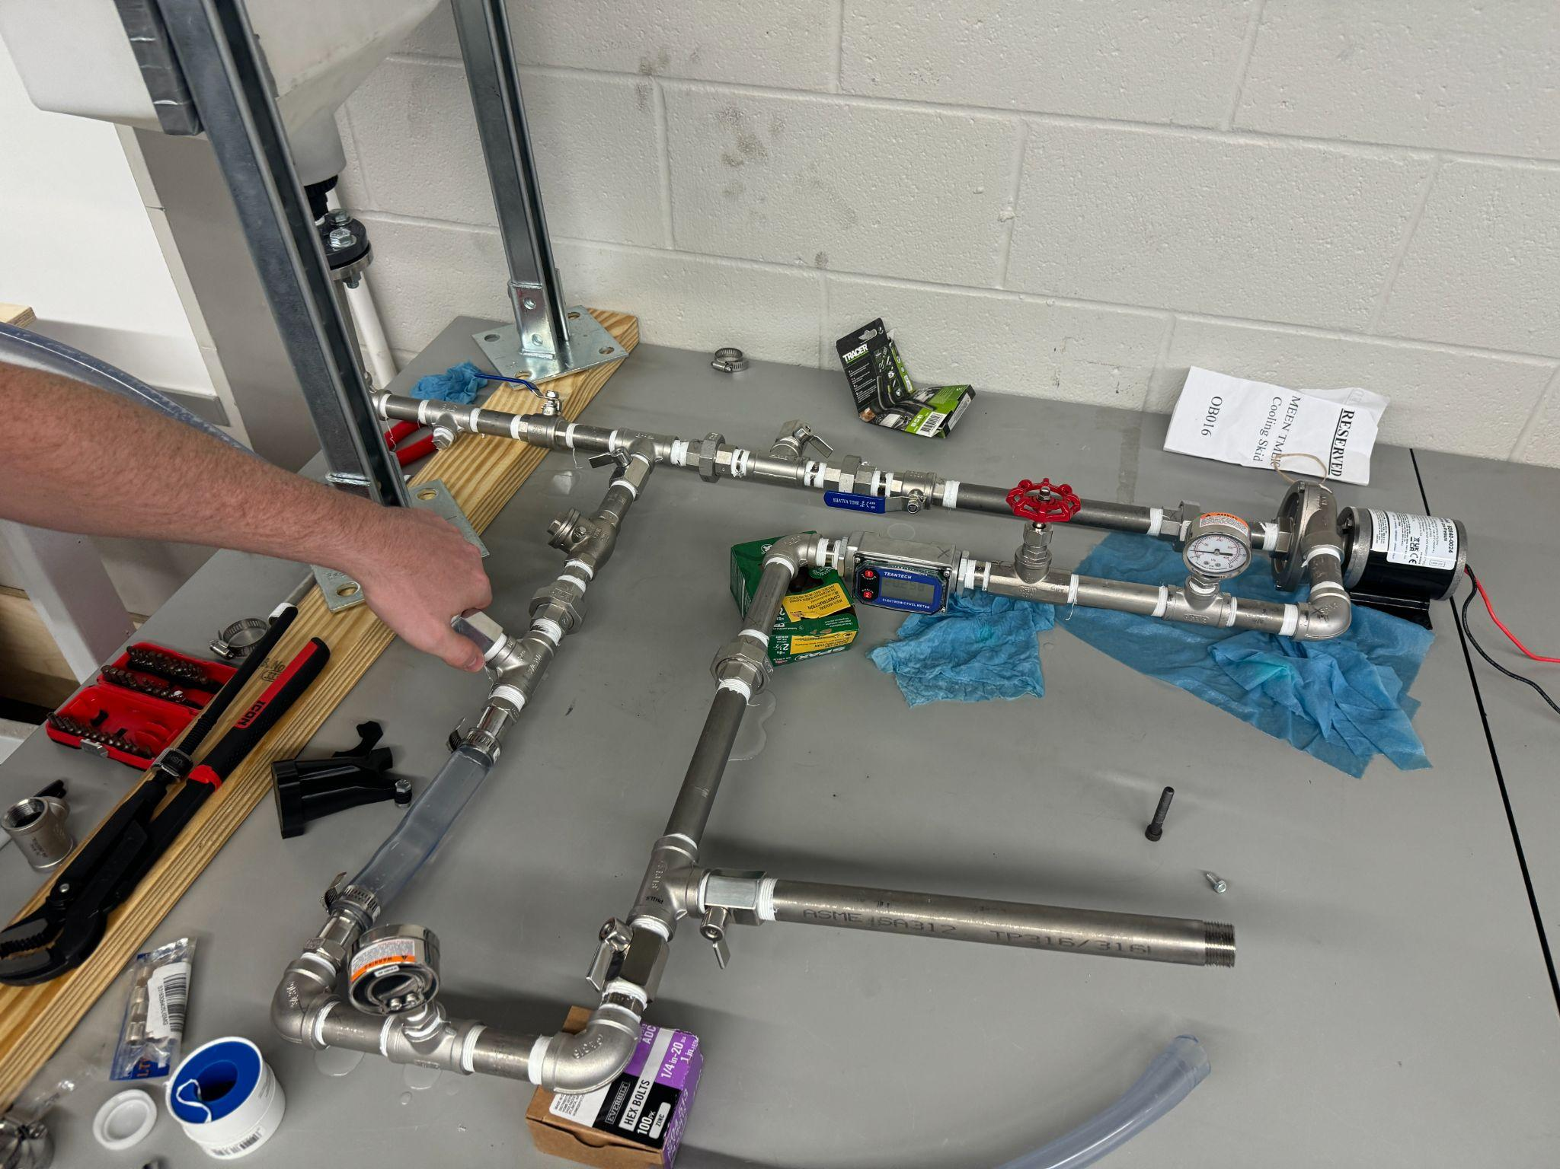
Phase I, II, and III Test Results
Manufacturer Pump Curves reflect controlled tested conditions. Our pump curve shows the effect the skid construction has on the operational capability of the pump which is the intent of the Phase I Test.
Water Reservoir
Pump
Pressure Gauge
Flow Control Valve
Flow Meter
Pressure Gauge

Slide 10
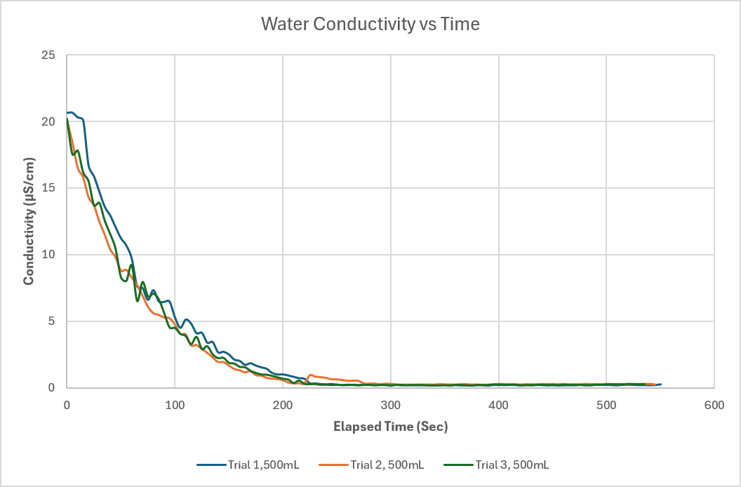
Phase I, II, and III Test Results
The Resin Filter will achieve our desired metric of ≤ 1μS/cm^2 and the behavior is fairly consistent with multiple water volumes. This test was for the Resin Filter alone using lab-provided conductivity measurements. An additional test is needed to verify our conductivity probe (target Thursday Oct. 15)
Phase II Resin Filter Test Results

Slide 11
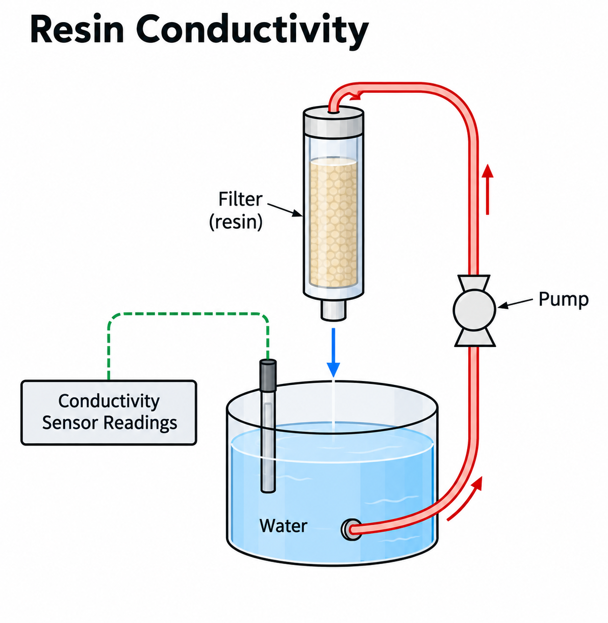
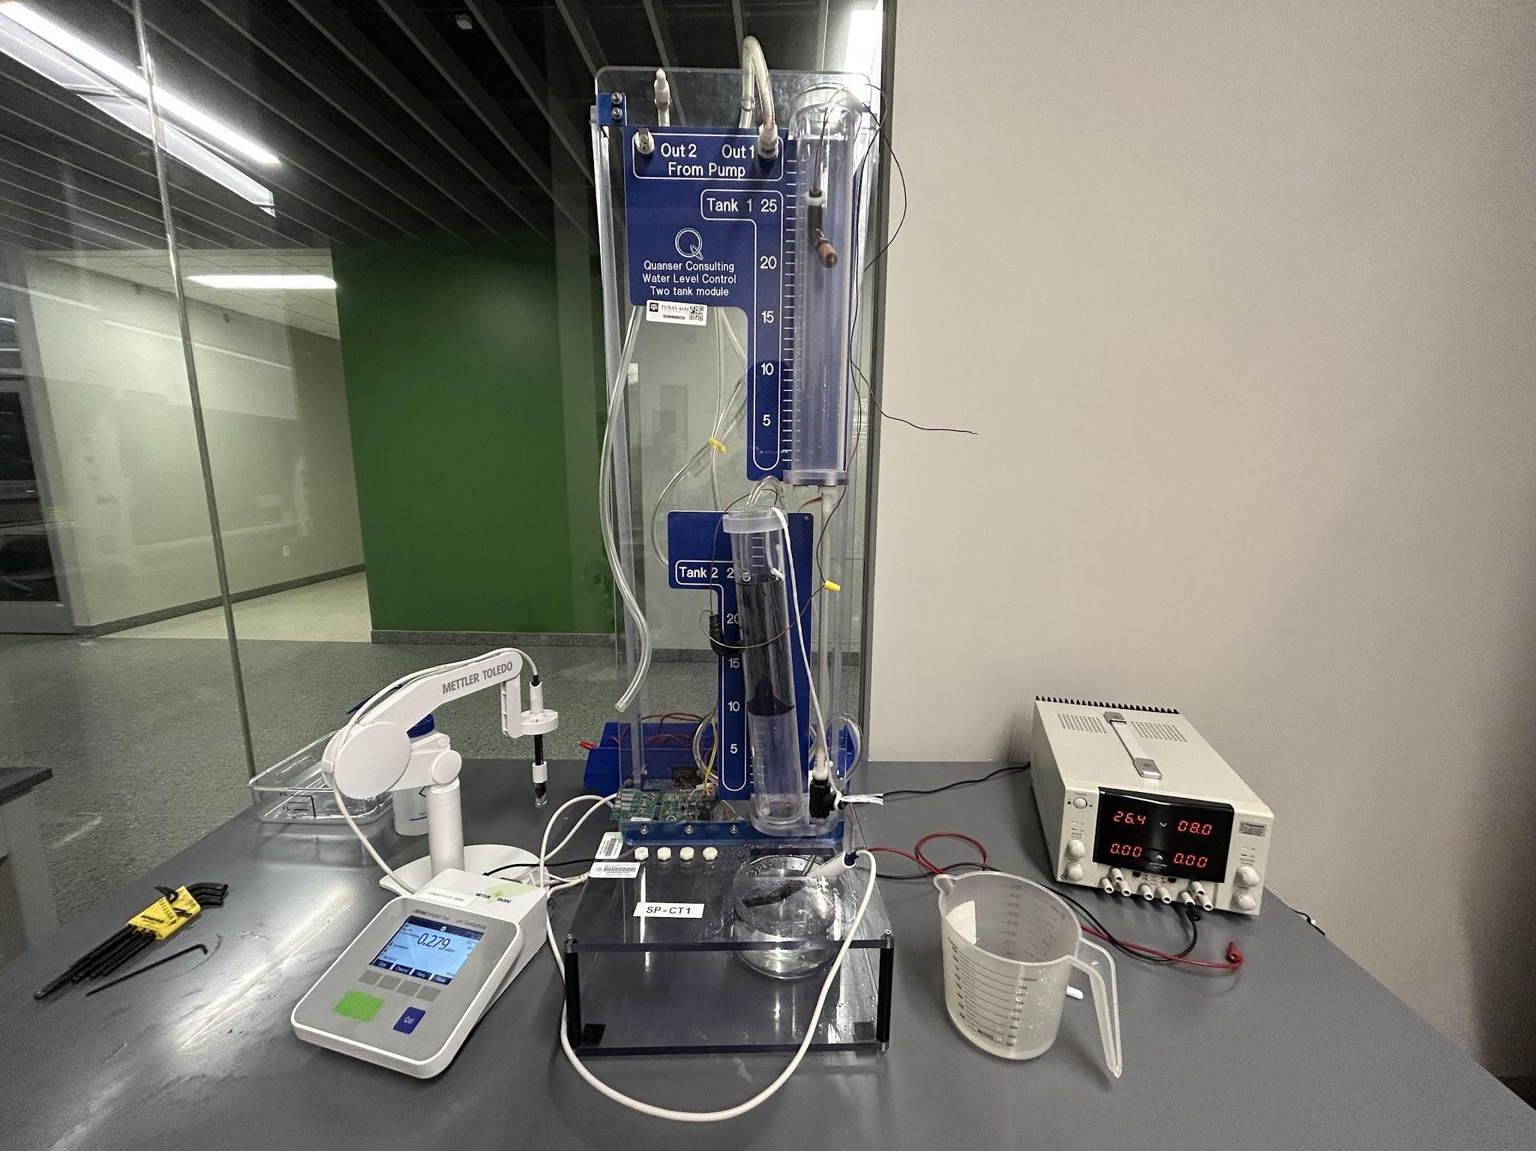
Phase I, II, and III Test Results
The Resin Filter will achieve our desired metric of ≤ 1μS/cm^2 and the behavior is fairly consistent with multiple water volumes. This test was for the Resin Filter alone using lab-provided conductivity measurements. An additional test is needed to verify our conductivity probe (target Thursday Oct. 15)

Slide 12
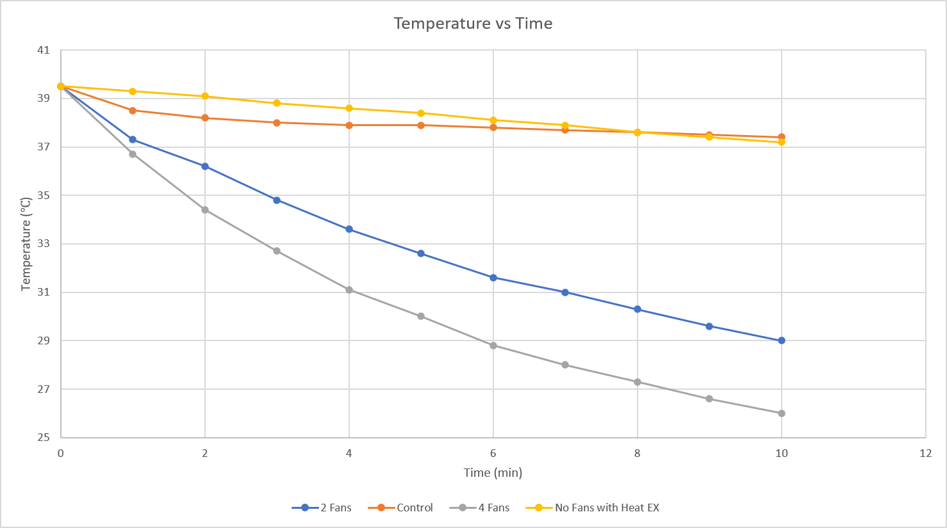
Phase I, II, and III Test Results
The Heat Exchanger performed as expected and the addition of fans adds desired confidence in its ability to cool the water down. The expectation is the Heat Exchanger cools down the water much faster than the heaters heat it up. So far, that behavior remains consistent.
Phase III Heat Exchanger Test Results

Slide 13
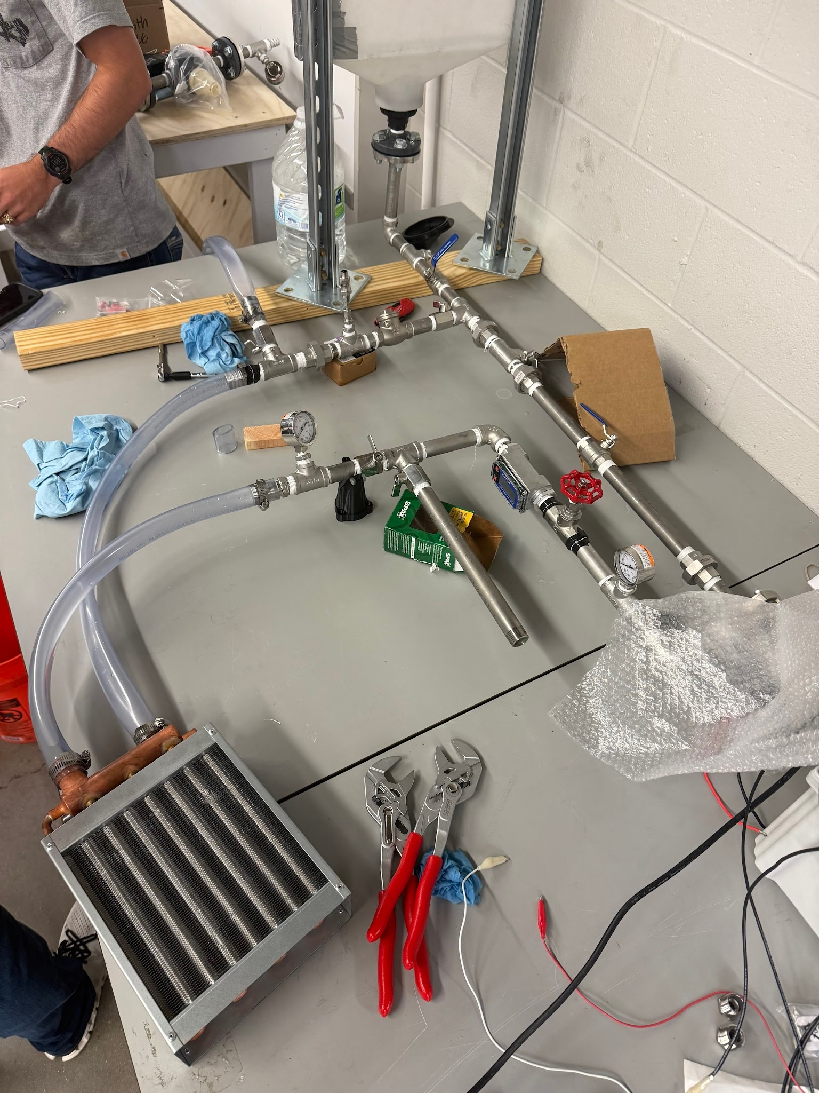
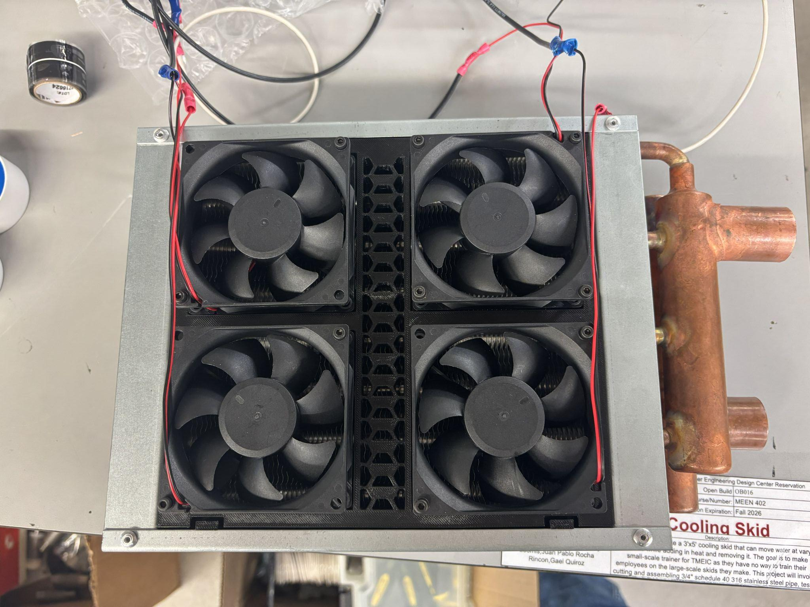
Phase I, II, and III Test Results
The Heat Exchanger performed as expected and the addition of fans adds desired confidence in its ability to cool the water down. The expectation is the Heat Exchanger cools down the water much faster than the heaters heat it up. So far, that behavior remains consistent.
Water Reservoir
RTD
Pressure Gauge
Flow Control Valve
Pump
Heat Exchanger

Slide 14
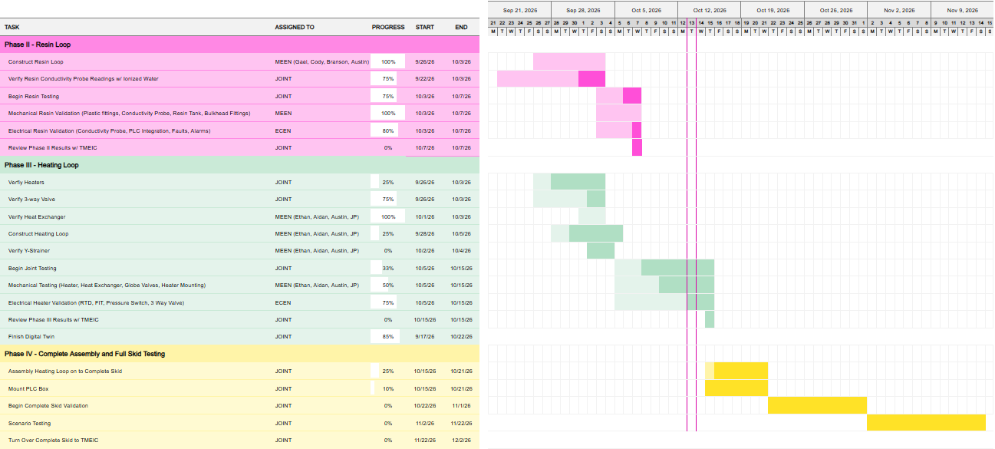
Execution Plan

Slide 15
Power | ECEN Team Lead
Ethan Henderson
Time Spent: ~10 Hrs
Accomplishments (9/30 - 10/14) | In Progress (10/14 - 10/28)
Worked with MEEN TL to establish new testing and construction strategy Wired complete skid on temporary mount and tested individual loads on complete system Started CAD model to determine organization and spacing for mounting into PLC box Putting a pause on final wiring diagram amidst potential minor redesigns following spacing and organization Assessed AC and DC load distribution, but is still subject to change for mounting logistics | Continue working to provide clarity on project-class requirements and expectations - video & report Continue to develop CAD model for organization and physical spacing of components Schedule downtime with testing to allow for mounting and re-wiring

Slide 16
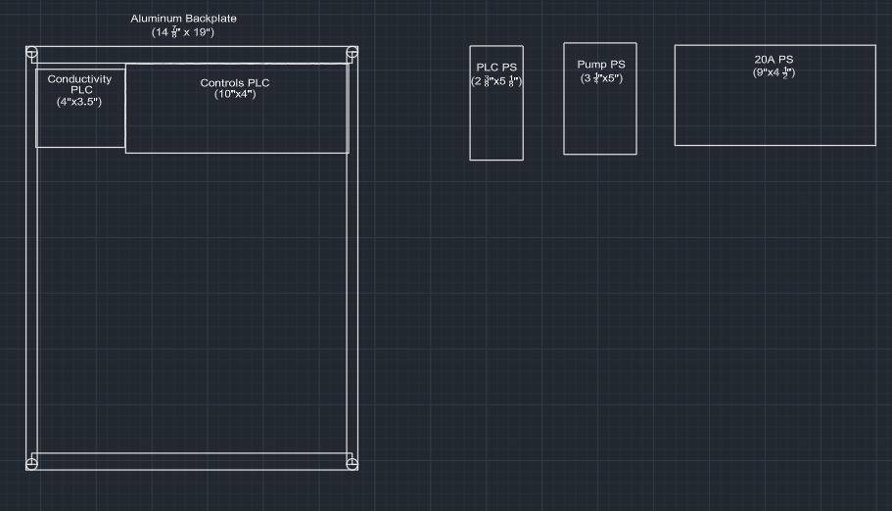
Power System
The strategy is to take rectangular measurements of every component and use the CAD to put the pieces together to determine best orientation/configuration of components, conduit termination, and wiring.

Slide 17
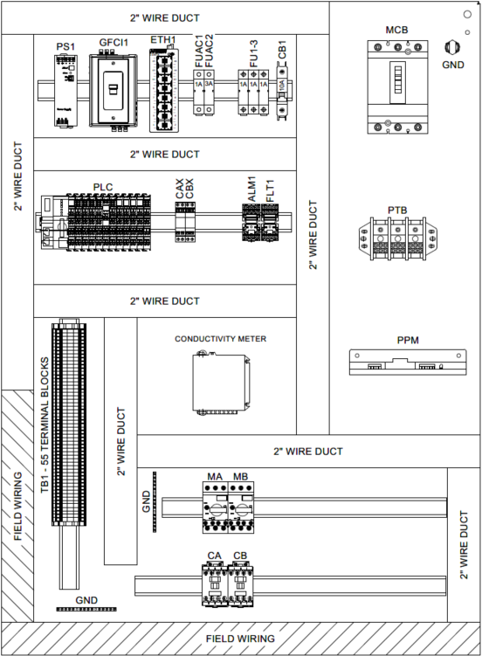
Power System
The strategy is to take rectangular measurements of every component and use the CAD to put the pieces together to determine best orientation/configuration of components, conduit termination, and wiring.
Need to account for spacing of PLCs for cooling purposes - need to consider the same for the power supplies
  being in an air-conditioned building helps alleviate some constraints
Wire ducts will need to be 1” and segment the different component “groups” (i.e. incoming AC, PLC, protection, control actuators, etc.)
Isolation of DIN Rails utilizing signal grounds
Special mounting of Main Power Switch (not shown), Heater Switch (not shown) and HMI Screen (not shown) on door of PLC enclosure
  Additional Conductivity HMI will need to be assessed for spacing after critical components have been installed

Slide 18
Control Hardware
Robert Parker
Time Spent: ~20 Hrs
Accomplishments (9/30 - 10/14) | In Progress (10/14 - 10/28)
Tested running 3-way valve actuator from PLC Software Installed and Tested Resistance Temperature Detector in Heat Exchanger test Added System State indicator to HMI screen | Install and Test Flow Transmitter Test Conductivity Transmitter with Resin Filter Document PLC Wiring Connections for Rebuild in Controls Box

Slide 19
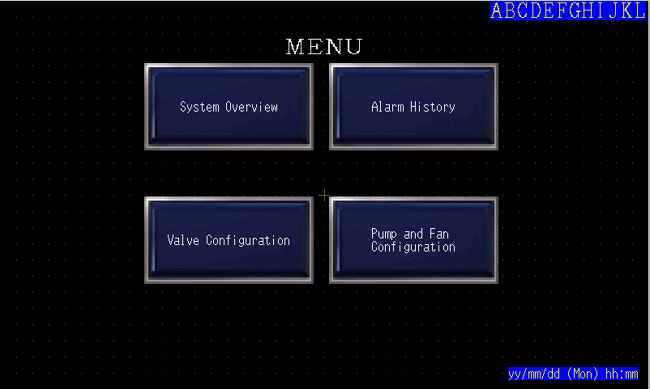
Control Hardware
HMI Screen Update
Figure CH.1: State indicator (Top Right) Shows current state of system ex: Calibrating,Ready,Online

Slide 20
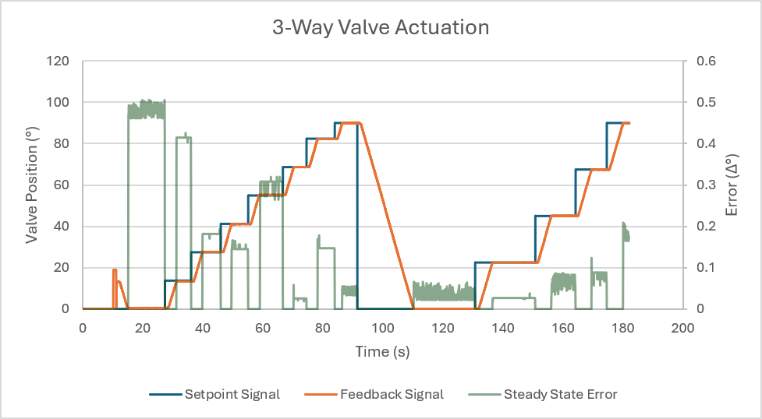
Control Hardware
3-Way Valve Actuator Test Results
Position error in steady state stayed less than 1 degree
Figure CH.2: Open loop 3-Way Valve Setpoint, Feedback and Error
Valve was Moved between Open(0 degrees) and Fully Closed (90 degrees)

Slide 21
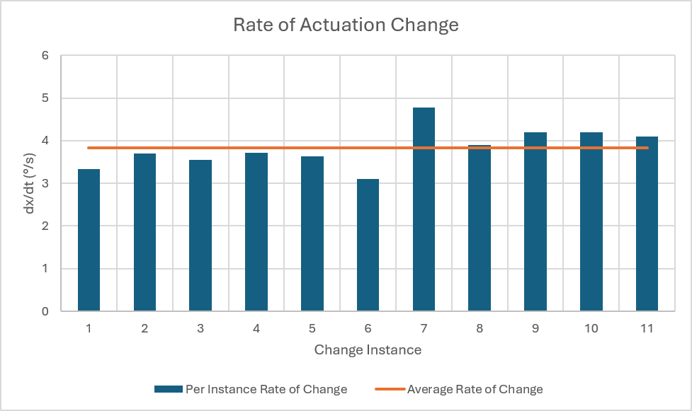
Control Hardware
3-Way Valve Actuator Test Results
Actuators Rotational Speed Stayed Consistent between 3 Degree/s & 5 Degree/s
Figure CH.3: Open loop 3-Way Valve Rate of Change during Test

Slide 22
Control Software
Noah Ovikian
Time Spent: ~30 Hrs
Accomplishments (9/30 - 10/14) | In Progress (10/14 - 10/28)
Integration Implemented Instrument Data Collection Collected Heat Exchanger Data Collected 3-Way Valve Response Data PLC Logic Established Comms & Control w/ 3-Way Valve Tuned 3-Way Valve P-Controller Condensed Regulation Algorithms (Anti-Windup) | Integration Establish Comms w/ Flow Transmitter Test Conductivity-PLC Interface Finalize PLC-HMI Variable Mapping Begin Alarm Management w/ HMI PLC Logic Finalize Temperature Alarms/Faults Implement & Tune Outer PI-Controller

Slide 23
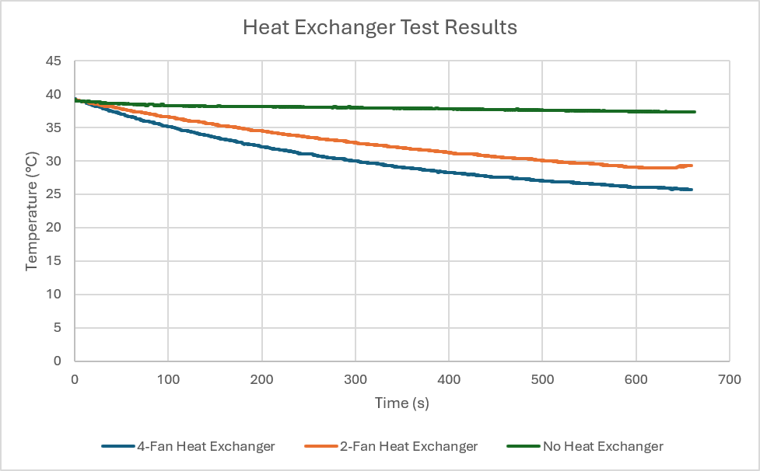
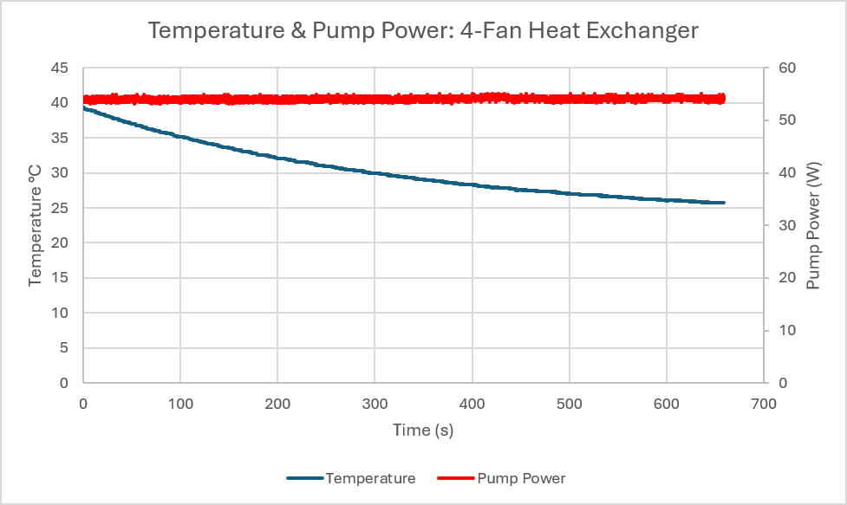
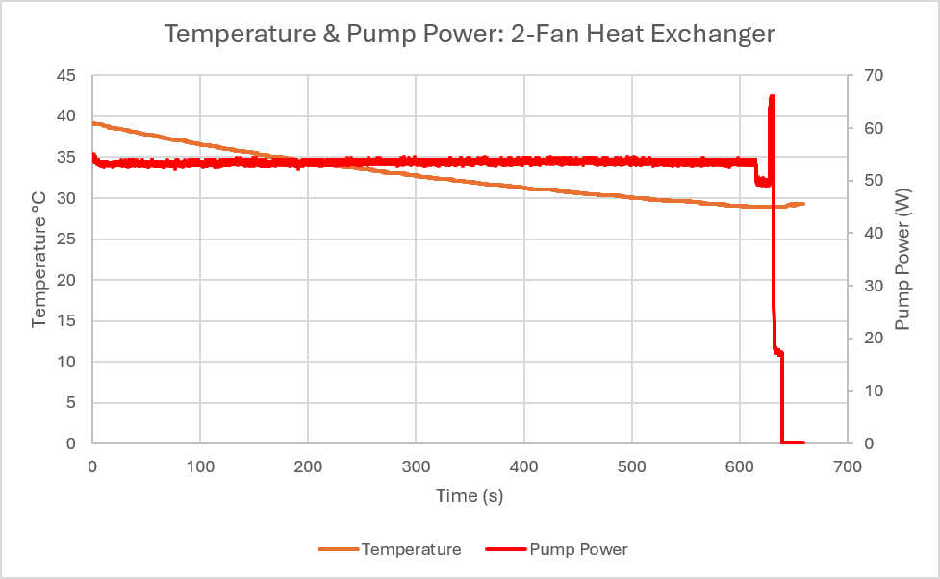
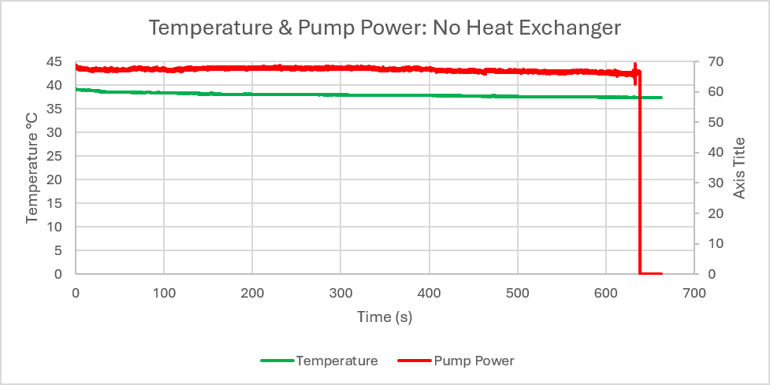
Control Software
Instrumentation Data Collection
An Interface Between All Subsystems
Observing:
Mechanical Data & Trends(e.g. temp, flow, etc)
Transient & Steady State Power Consumption of Instrument Tests
Instrumentation Response to System Dynamics and Signal Excitation
Software Regulation and Response to entire system.
Figure CS.1: 4 Graphs showing trends of Data Taken during Heat Exchanger Tests, Observing RTD temperature, and Pump Power, response to various heat exchanger results.

Slide 24
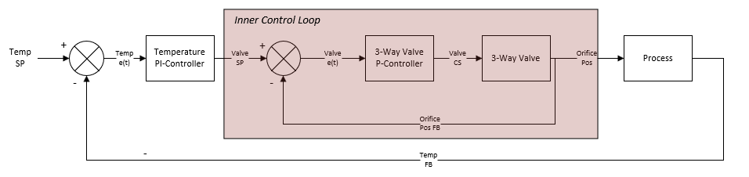
Control Software
Inner Control Loop
3-Way Valve Controller Purpose
Redundancy for Orifice Position Stabilization
Additional 3-Way Valve Feedback Regulation
Does NOT regulate temperature
Figure CS.2: Signal Block Diagram of Cascading Control Loop. Inner Control Loop composed of 3-Way Valve, and 3-Way Valve Controller. SP: Setpoint Signal, e(t): tracking error, CS: Command Signal, FB: Feedback Signal , Pos: Position.

Slide 25
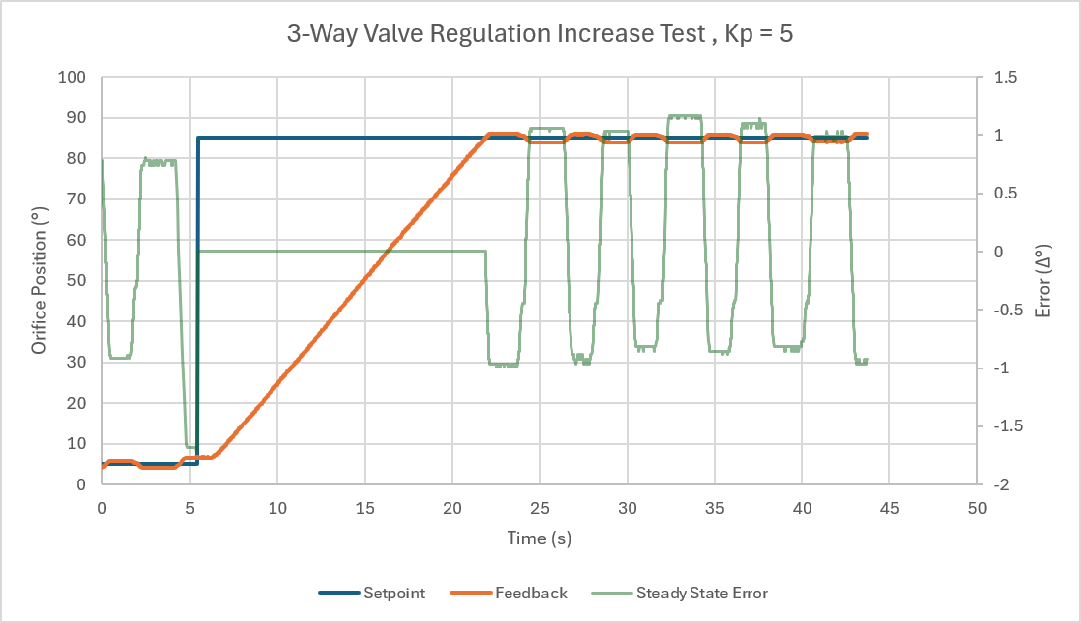
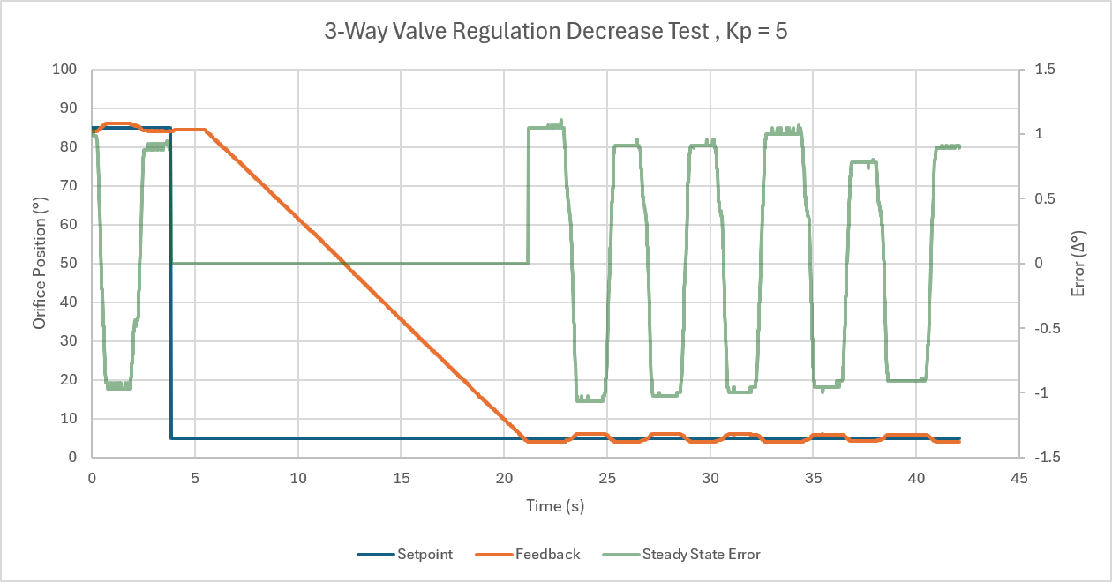
Control Software
Proportional Gain Tuning (Kp = 5)
Figure CS.3: (Left Image) Increasing setpoint from 5° to 85°. Feedback observed to consistently oscillate. (Right Image) Decreasing setpoint from 85° to 5°. Feedback observed oscillation with similar magnitude to increase test.

Slide 26
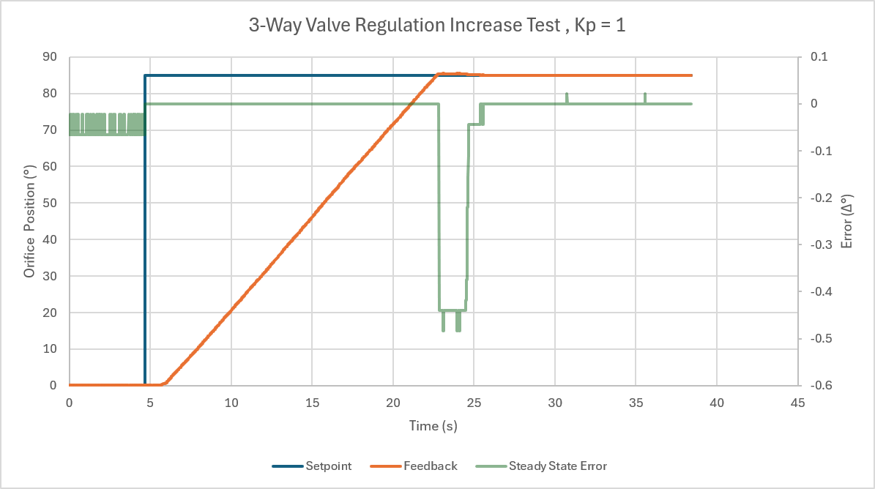
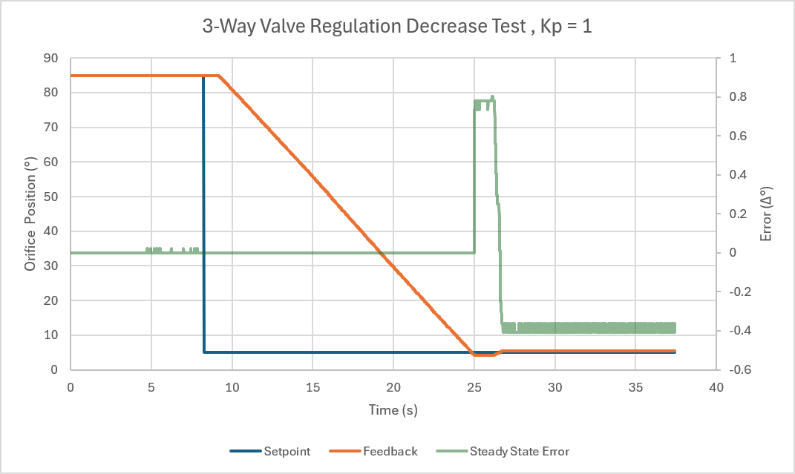
Control Software
Proportional Gain Tuning (Kp = 1)
Figure CS.4: (Left Image) Increasing setpoint from 5° to 85°. Observed slight overshoot from feedback, followed by subsequent correction. (Right Image) Decreasing setpoint from 85° to 5°. Observed slight overshoot from controller, followed by subsequent correction.

Slide 27
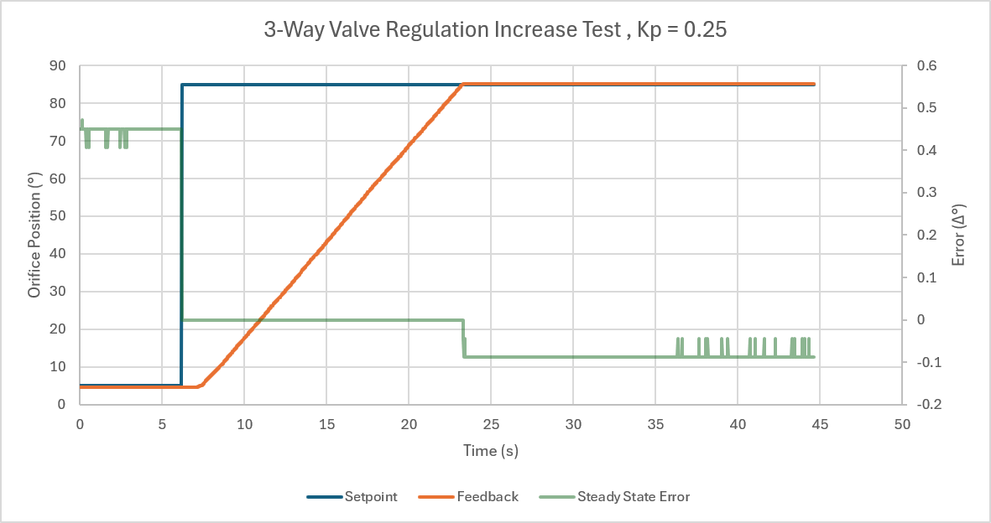
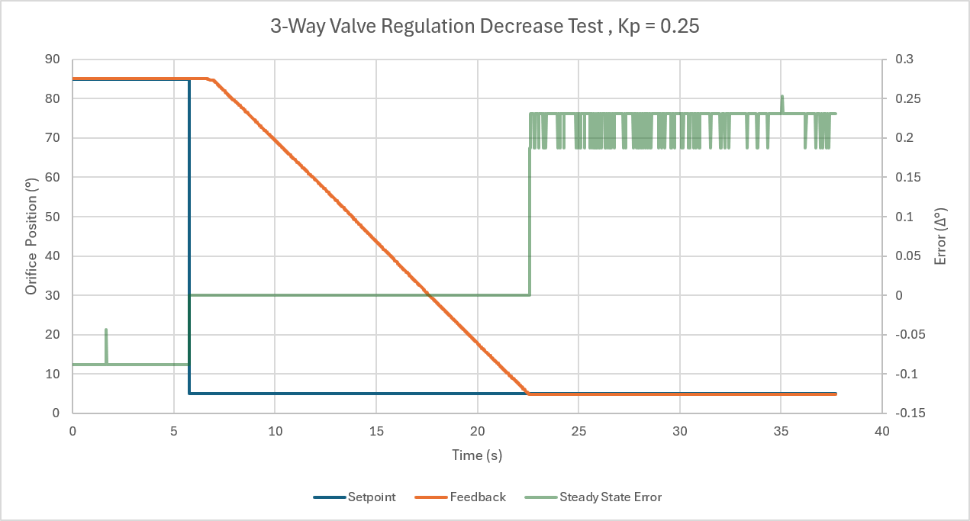
Control Software
Proportional Gain Tuning (Kp = 0.25)
Figure CS.5: (Left Image) Increasing setpoint from 5° to 85°. Controller regulates feedback with no overshoot. (Right Image) Decreasing setpoint from 85° to 5°. Controller regulates feedback with no overshoot.

Slide 28
Control Software
Inner Control Loop
Integral Term Risks
System Destabilization from Addn. Pole
Windup Caused from Inherent Deadband
Derivative Term Risks
Inflated tracking error from noise amplification
Bottom Line
Figure CS.6: (Top Image) Flatness in oscillation within valve feedback (circled red) indicate potential deadzone - likely from final control element. (Bottom Image) Noise in tracking error likely from system precision
Failsafe/Redundancy for Final Control Drifting
Control Mostly Handled in Final Control Element
Modify Controller for Temp regulation as necessary

Slide 29
MEEN Integration
Phase II

Slide 30
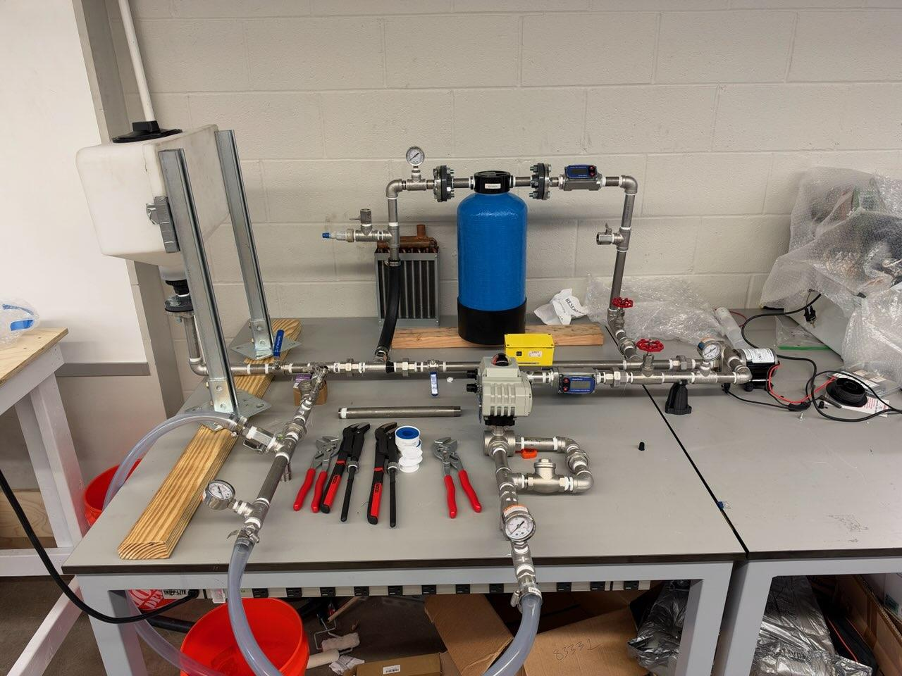
MEEN Integration
Phase II
Water Reservoir
Flow Meter
Resin Filter
Conductivity Probe
Pump
Flow Control Valve
Flow Meter
Flow Transmitter
3-Way Valve

Slide 31
Thank You

